Slide 1
Module 04: Objects and Classes
Chapter 9

Slide 2


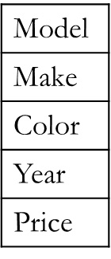
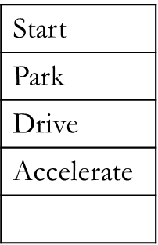

Motivation
Class
Objects
Notes:
Classes and objects are the two main aspects of object-oriented programming.
A class is the blueprint from which individual objects are created.
In the real world, for example, there may be thousands of cars in existence, all of the same make and model.
Each car was built from the same set of blueprints and therefore contains the same components. In object-oriented terms, we say that your car is an instance (object) of the class Car.

Slide 3
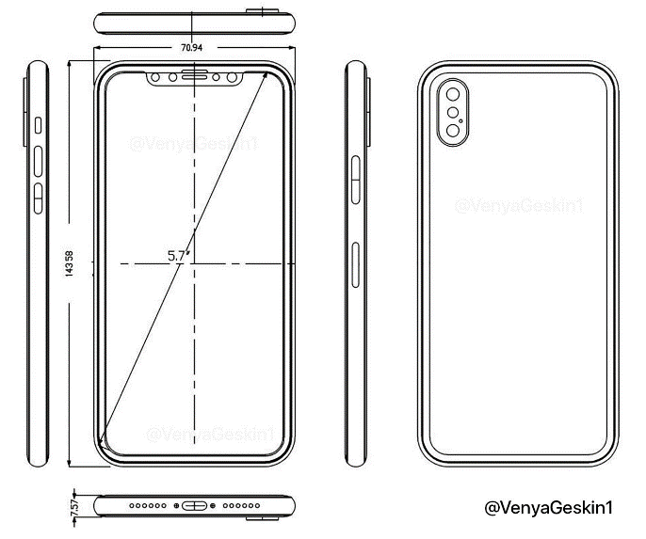



Motivation
Mobile phones
Characteristics
Brand name
Actions
Store contacts
Manufacturer year
Color
Memory size
Dial numbers
Receive calls
Ring

Slide 4
Objectives
To understand objects and classes (§9.2).
To model classes using UML graphical notation (§9.2).
To define classes and create objects(§9.3).
To create objects using constructors (§9.4).
To access objects via object reference variables (§9.5.1.-9.5.3).
To access an object’s data and methods.
To define data fields of reference types.
To distinguish between object reference variables and primitive data type variables (§9.5.4).
To use the Java library classes (§9.6).
To distinguish between instance and static variables and methods (§9.7).
To understand visibility Modifiers (§9.8).

Slide 5
Objectives
To encapsulate data fields by defining private data fields with appropriate get and set methods (§9.9).
To develop methods with object arguments (§9.10).
To store and process objects in arrays (§9.11).
To create immutable objects from immutable classes to protect the contents of objects (§9.12).
To determine the scope of variables in the context of a class(§9.13).
To use the keyword this to refer to the calling object itself (§9.14).
To understand constructors overloading and call chain of constructors.

Slide 6
Programming Paradigms
Procedural paradigm:
Programs consist of a collection of procedures and functions that operate on data.
Fortran, Pascal, and C.
Object-oriented paradigm:
Not a programming language.
A model in which programs are organized around objects.
Programs are viewed instead as a collection of “objects,” for which data and the associated operations are encapsulated into integrated units.
Smalltalk, C++, and Java.
Notes:
OOP allows you to describe the problem in terms of the problem, rather than in terms of the computer where the solution will run. There’s still a connection back to the computer: Each object looks quite a bit like a little computer—it has a state, and it has operations that you can ask it to perform. However, this doesn’t seem like such a bad analogy to objects in the real world—they all have characteristics and behaviors.

Slide 7
Objects
A Java program consists of objects of various classes interacting with each other.
Objects in a program can represent either:
Objects in the real word—like students, books, and houses.
Abstractions like colors, shapes, and words.
An object has state (data) , and behavior (actions).
The state:
represented by data fields with their current values. A circle has a radius.
The behavior:
represented by methods. e.g. computeAarea.
Notes:
Object-oriented programming (OOP) involves programming using objects.
An object represents an entity in the real world that can be distinctly identified. For example, a student, a desk, a circle, a button, and even a loan can all be viewed as objects.
An object has a unique identity, state, and behavior.
the state of an object (also known as its properties or attributes) is represented by data fields with their current values.
A circle object, for example, has a data field radius, which is the property that characterizes a circle.
A rectangle object, for example, has the data fields width and height, which are the properties that characterize a rectangle.
The state of an object consists of a set of data fields (also known as properties) with their current values.
The behavior of an object is defined by a set of methods.
The behavior of an object (also known as its actions) is defined by methods. To invoke a method on an object is to ask the object to perform an action. For example, you may define methods named getArea() and getPerimeter() for circle objects.
A circle object may invoke getArea() to return its area and getPerimeter() to return its perimeter. You may also define the setRadius(radius) method. A circle object can invoke this method to change its radius.

Slide 8
Classes
Objects of the same type are defined using a common class.
A class is a template, blueprint, or contract that defines what an object’s data fields and methods will be.
A class specifies the attributes, or data, that objects of the class have. (Variables).
The class also specifies what actions the objects can take and how they accomplish those actions. (Methods).
An object is an instance of a class.
You can create many instances of a class.
Creating an instance is referred to as instantiation.

Slide 9
Defining Classes
A class has a name and consists of:
Data field (Variables)
Constructors
Methods
General form of a class:
Class
Variables
Constructors
access-specifier class ClassName { variables
constructors
methods
}
Methods
Field declarations
Modifiers, such as public, protected or private.
The field's type, such as int, double, String or Date.
The field's name.
Variables are also called fields.
Fields and methods are members.

Slide 10
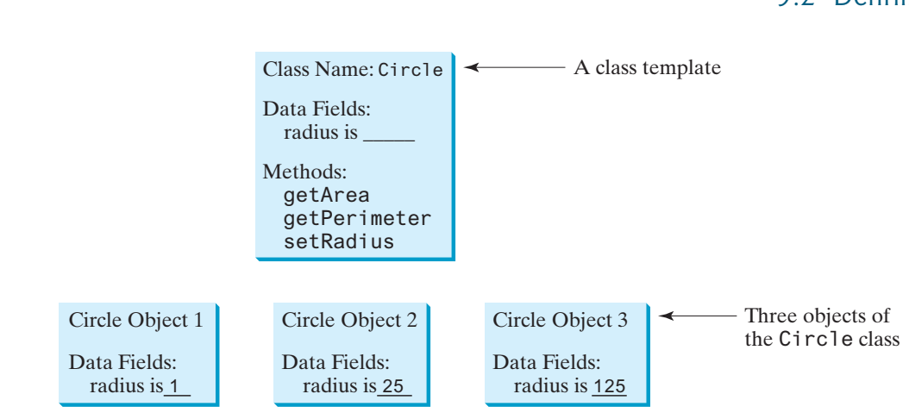
Classes and Objects: Examples
Person
name
id
age
address
getName
getID
getAge
getAddress
A class template
Person Obj1
name: Hani
Id:11024564341
age:22
city:DMM
Person Obj2
name: Salim
Id:1101567899
age:30
city:RYD

Slide 11
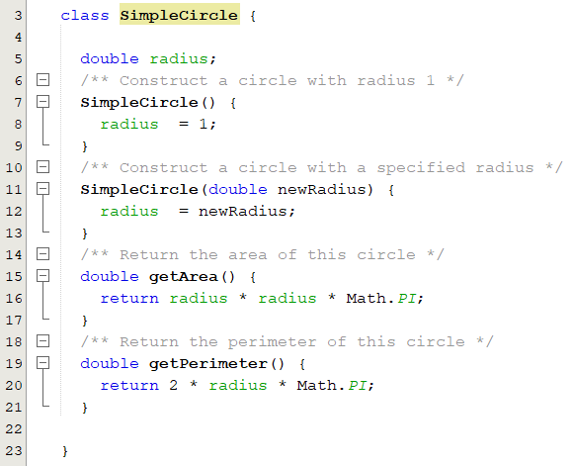
Defining Classes: Example 1
Data field
Constructors
Methods

Slide 12
UML Class Diagram
SimpleCircle
radius: double
SimpleCircle() SimpleCircle(newRadius: double) getArea(): double getPerimeter(): double
Class name
Data fields
dataFieldName: dataFieldType
Constructors
ClassName(parameterName: parameterType
methods
methodName(parameterName: parameterType): returnType
circle1: SimpleCircle
radius = 1
circle2 :SimpleCircle
radius = 25
circle3 :SimpleCircle
radius = 125
UML notation
for objects

Slide 13
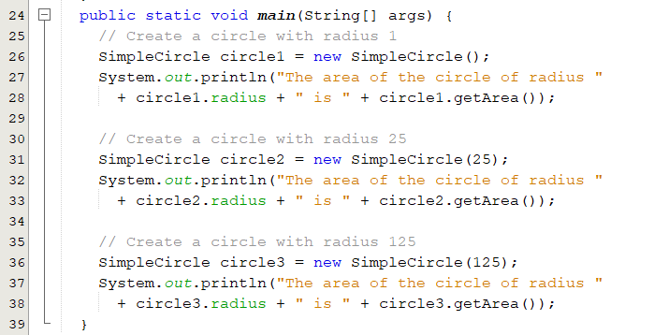
Creating Objects
A class is essentially a user-defined type.
A class is a reference type.
Declare an object:
ClassName objectRefVar; Example: SimpleCircle myCircle;
Create an object:
objectRefVar = new ClassName();
Example: myCircle = new SimpleCircle();
Declare and create an object:
Syntax: ClassName objectName = new ClassName(parameters);
The new operator is used to create an object from the constructor: new SimpleCircle().
Objects are stored in the heap.
Notes:
The program contains two classes. The first of these, TestCircle, is the main class. Its sole purpose is to test the second class, Circle. Such a program that uses the class is often referred to as a client of the class. When you run the program, the Java runtime system invokes the main method in the main class

Slide 14
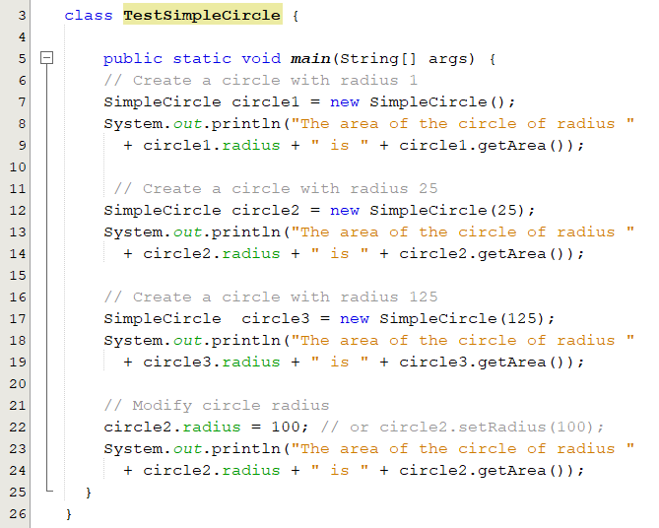
Accessing Object’s Members
Objects members are accessed via the object’s reference variables using the dot operator (.), the object member access operator.
Referencing the object’s data:
objectRefVar.dataField
e.g., circle1.radius
Invoking the object’s method:
objectRefVar.methodName(arguments)
e.g., circle1.getArea()
The three objects have different data but the same methods.

Slide 15
Popup-Question(1)
How do you define a class?
How do you declare an object's reference variable?
How do you create an object?
class ClassName {
}
ClassName referenceVariable;
new ClassName();
ClassName referenceVariable = new ClassName();

Slide 16
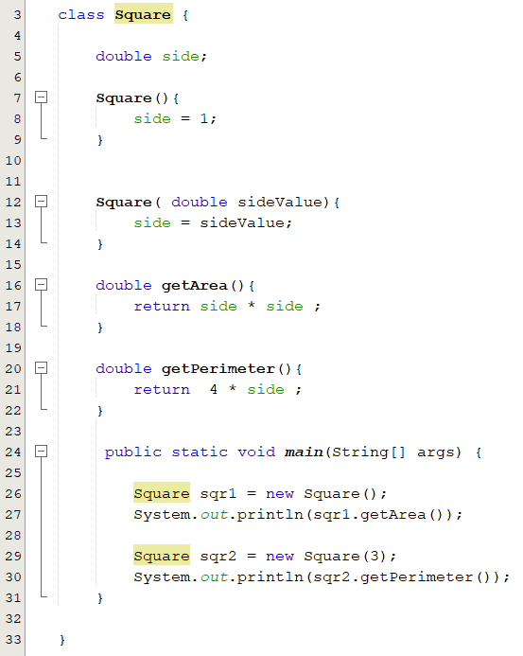
Popup-Question(2)
Define a class named Square with the following characteristics:
Data fields
Constructors
Methods
Write a test program
Create two squares
Draw the class diagrams

Slide 17
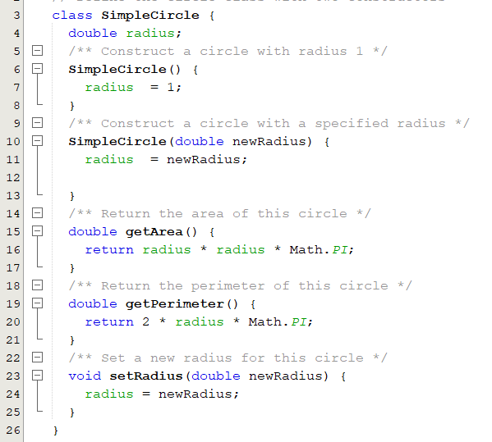
Constructors
A class provides methods of a special type, known as constructors.
Invoked using the new operator when an object is created.
Must have the same name as the class itself.
Do not have a return type - not even void.
Can not declared as static
Used to initialize the data fields of objects.
SimpleCircle circle1 = new SimpleCircle ();
A constructor with no parameters is referred to as a no-arg constructor.
Parameterized Constructors
Notes:
Constructors are a special kind of methods that are invoked to construct objects.
Constructors are used to construct objects.
To construct an object from a class, invoke a constructor of the class using the new operator
A class normally provides a constructor without arguments (e.g., Circle()). Such a constructor is referred to as a no-arg or no-argument constructor
Constructor is a block of code that initializes the newly created object.
Constructor has same name as the class and looks like this in a java code.
A constructor initializes an object immediately upon creation. It has the same name as the class in which it resides and is syntactically similar to a method. Once defined, the constructor is automatically called when the object is created, before the new operator completes.

Slide 18
Constructors: The Default Constructor
A no-arg constructor with an empty body is provided automatically by the compiler only if no constructors are explicitly defined in the class.
This constructor, called a default constructor.
If a class has only parameterized constructors, you can not instantiate objects with no-arg constructor.
SimpleCircle circle1 = new SimpleCircle ();
×

Slide 19
Trace Code
3
1
2
6
4
5
1
circle1
null
4
circle2
null
SimpleCircle
radius = 1
SimpleCircle
radius = 25
2
5
3
circle1
6
circle2

Slide 20
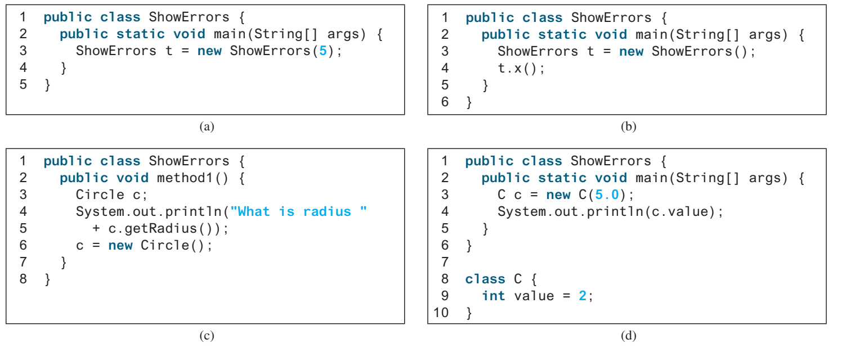
Popup-Question(3): Checkpoint 9.5.5
What is wrong with each of the following programs?
(a) There is no such constructor ShowErrors(int) in the ShowErrors.
(b) x() is not a method in the ShowErrors class.
(c) It has a runtime error because variable c is null when the println statement is executed.
(d) new C(5.0) does not match any constructors in class C.

Slide 21
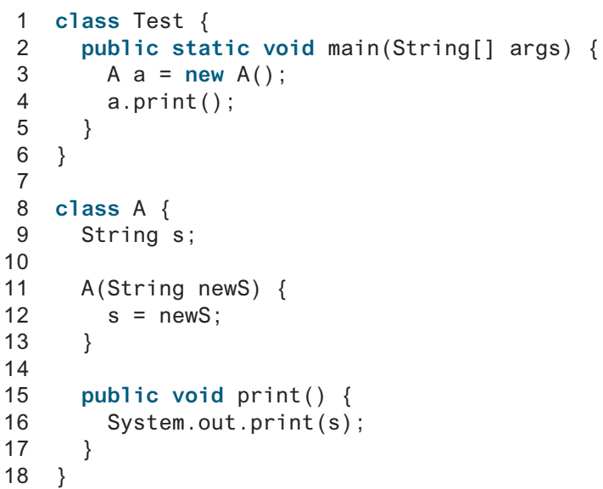
Popup-Question(4): Checkpoint 9.5.6
What is wrong in the following code?
Compilation error:
- new A() is used in class Test, but class A does not have a default constructor.

Slide 22
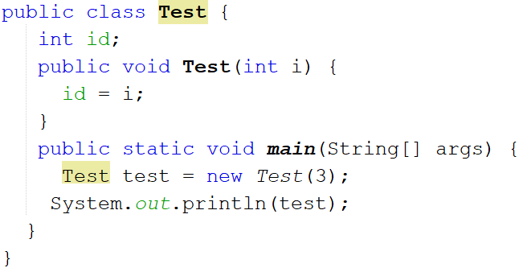
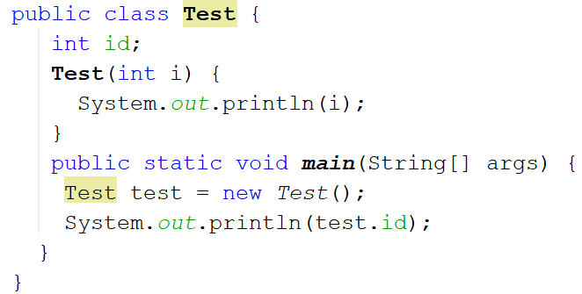
Popup-Question(5)
What is wrong in the following programs?
The constructor is defined incorrectly
It should be declared with no return type
There is no no-arg constructor and the compiler does not insert a default one since the class has a parametrized constructor.

Slide 23

Defining Classes: Example (1/2)
Television sets.
Each TV is an Object.
TV
channel: int volumeLevel: int on: Boolean
+TV() +turnOn(): void +turnOff(): void +setChannel(newChannel: int): void +setVolume(newVolumeLevel: int): void +channelUp(): void +channelDown(): void +volumeUp(): void +volumeDown(): void
The current channel (1 to 120) of this TV. The current volume level (1 to 7) of this TV. Indicates whether this TV is on/off.
Constructs a default TV object. Turns on this TV. Turns off this TV. Sets a new channel for this TV. Sets a new volume level for this TV. Increases the channel number by 1. Decreases the channel number by 1. Increases the volume level by 1. Decreases the volume level by 1.

Slide 24
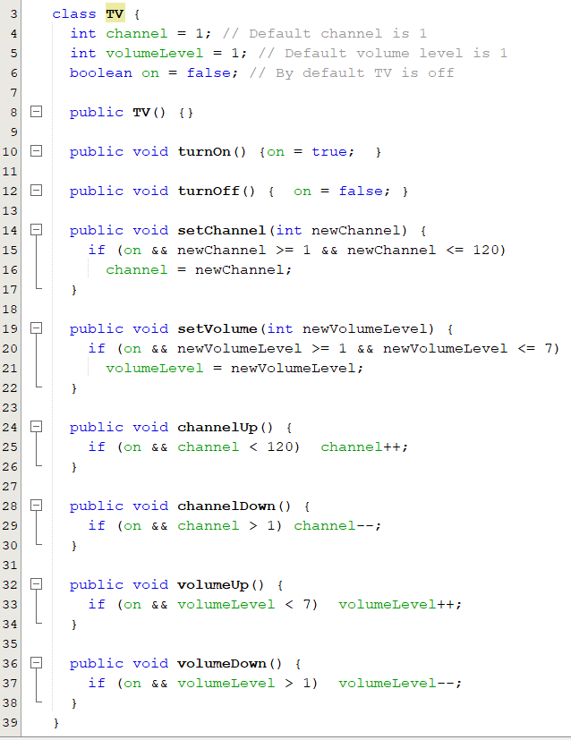
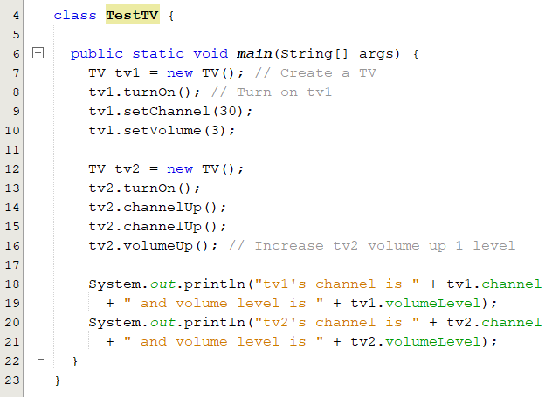
Defining Classes: Example (2/2)

Slide 25
Default Value for a Data Field
Data type | Default Value | Notes
Numeric type( byte, short, int, long, float, double ) | 0 | int x; //x is 0
char | ‘\u0000’ | char ch; //ch is ‘\u0000’
boolean | false | boolean b; // b is false
Reference type ( objects) | null | SimpleCircle circle; String name; //circle and name are null. NullPointerException occurs when you invoke a method on a reference variable with a null value.
Java assigns no default value to a local variable inside a method. We have to initialize them. Otherwise, a compilation error is raised.

Slide 26
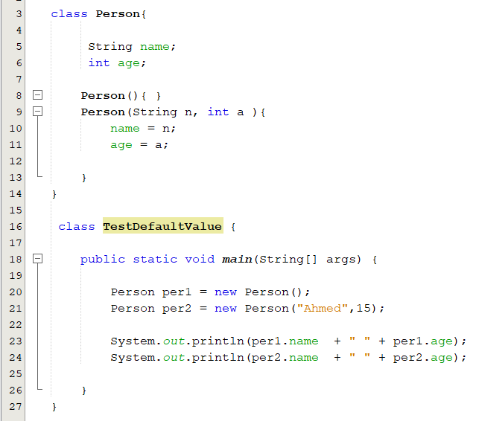
Popup-Question(6)
What is the output of the following program
null 0
Ahmed 15

Slide 27
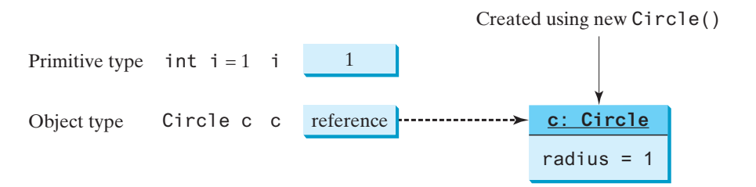
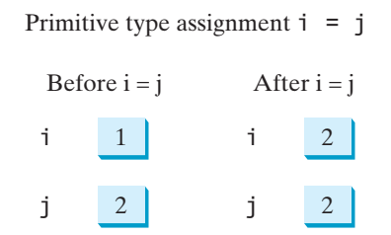
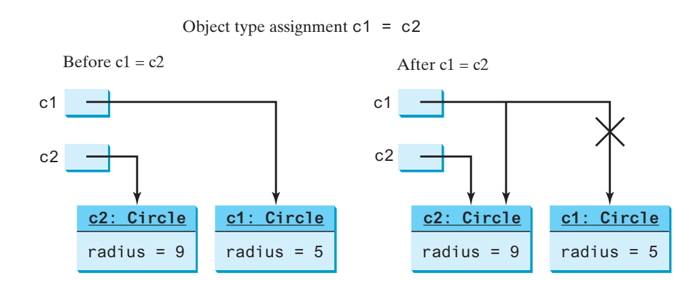
Variables of Primitive Types and Reference Type
A variable of a primitive type:
The value is of the primitive type.
A variable of a reference type:
The value is a reference to where an object is located.
Variables assignment:
A variable of a primitive type:
the real value of one variable is assigned to the other variable
A variable of a reference type:
the reference of one variable is assigned to the other variable.
The JVM will automatically collect the memory if the object is not referenced by any variable.
Notes:
Every variable represents a memory location that holds a value. When you declare a variable, you are telling the compiler what type of value the variable can hold. For a variable of a primitive type, the value is of the primitive type. For a variable of a reference type, the value is a reference to where an object is located. For example, as shown in Figure 9.7, the value of int variable i is int value 1, and the value of Circle object c holds a reference to where the contents of the Circle object are stored in memory.

Slide 28
Using Classes from the Java Library: The Date Class
Used to create an instance for the current date and time
java.util.Date date = new java.util.Date()
java.util.Date
+Date() +Date(elapseTime: long) +toString(): String +getTime(): long +setTime(elapseTime: long): void
Constructs a Date object for the current time. Constructs a Date object for a given time in milliseconds elapsed since January 1, 1970, GMT. Returns a string representing the date and time. Returns the number of milliseconds since January 1, 1970, GMT. Sets a new elapse time in the object.
java.util.Date date = new java.util.Date();
System.out.println(date.toString());
displays a string like Thu Feb 04 23:49:18 AST 2021
Notes:
Java provides a system-independent encapsulation of date and time in the java.util.Date class. You can use the Date class to create an instance for the current date and time and use its toString method to return the date and time as a string.

Slide 29
Visibility Modifiers
Visibility modifiers are used to define the accessibility and scope of a class and its members.
An access modifier must be specified whenever a class, variable or method is being defined.
Public | Classes, data fields and methods can be accessed from other classes.
Default (no keyword) | Classes, data fields and methods can be accessed by any class in the same package. This is known package-access.
Protected | Data fields and methods can be accessed within the same package or subclasses in different packages
Private | Data fields and methods can be accessed only from within their own class.
Only public and default modifier can be used with classes.
All modifiers can be used with variables and methods.
Local variables can not be declared public, protected or private.
Notes:
A visibility modifier specifies how data fields and methods in a class can be accessed from
outside the class. There is no restriction on accessing data fields and methods from inside the
class.

Slide 30
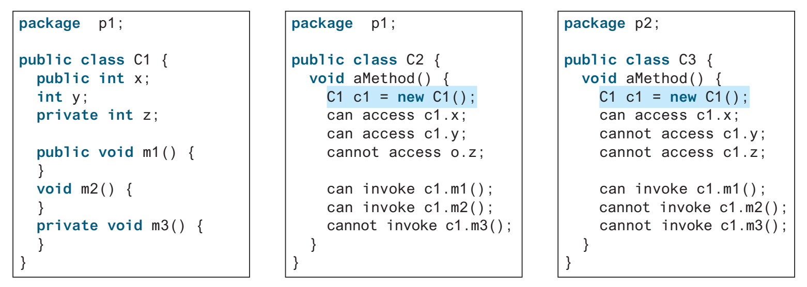
Visibility Modifiers: Examples
Class members | Inside the class | Same Package | Another Package
Public | Yes | Yes | Yes
Protected | Yes | Yes | No ( Yes if subclass)
Default (no keyword) | Yes | Yes | No
Private | Yes | No | No
What would happen if we remove the public modifier from C1?

Slide 31
Visibility Modifiers & Constructors
In most cases, the constructor should be public.
Use a private constructor to prohibit the user from creating an instance(object) of a class.
The constructor in java.lang.Math is private, because all of its members are static, no need to create object of the math class.
A compilation error if you try to create an object of a class that has a private constructor.
Math m = new Math(); //compilation error

Slide 32
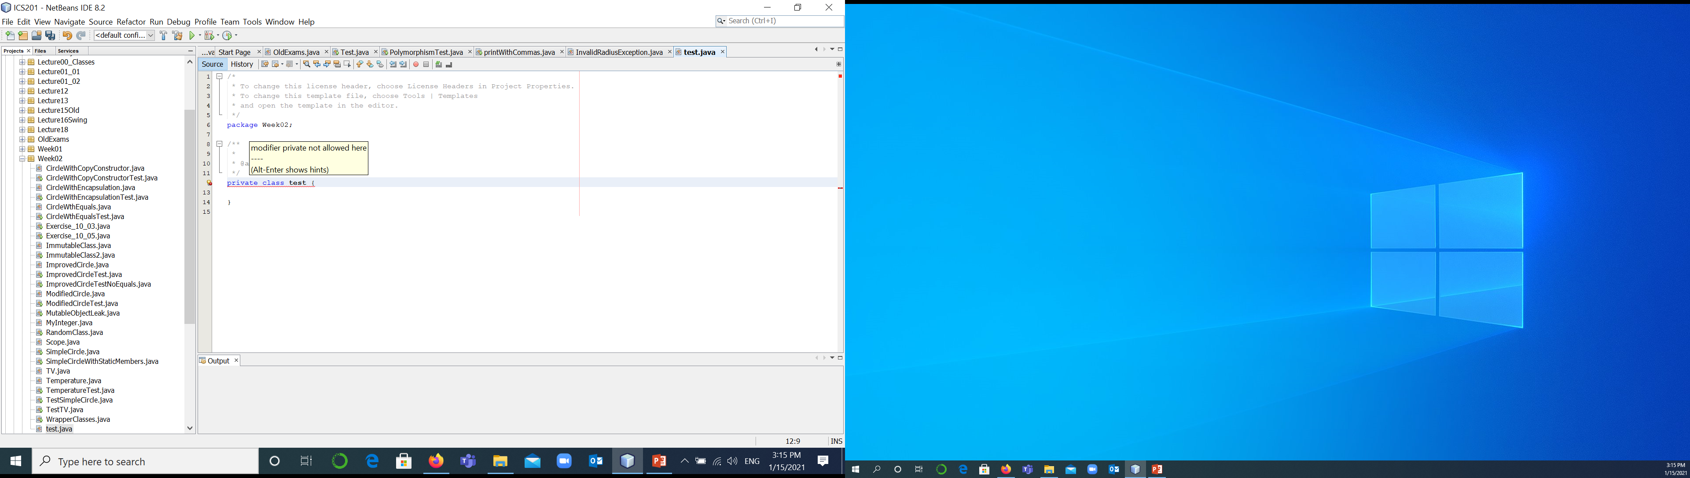
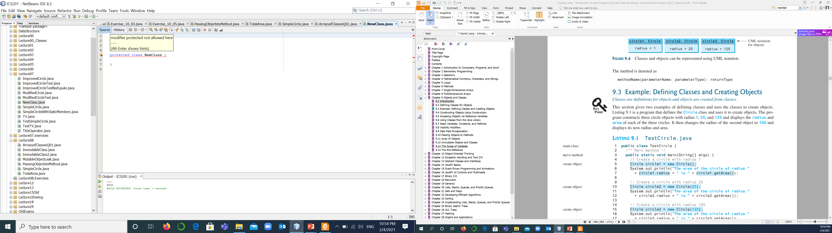
Classes’ Access Modifiers
Access modifiers: public, private, protected, default (no access modifier).
Classes in Java can be declared either public or with no modifier, package level access.
Classes cannot be declared private or protected.
Public classes can be accessed from different packages.
Classes with package level access can be accessed only in their own package.

Slide 33
Organizing Classes Inside Packages
A class is declared in the same file of the calling class
A class is declared in a separate file in the same package of the calling class:
Can be declared public or with no access modifier ( package level access).
A class is declared in a different package of the calling class must be declared public.
//File TestSimpleCircle1 .java
public class TestSimpleCircle1 {
}
class SimpleCircle1{
}
Must has no access modifier ( package ).
TestSimpleCircle1.class
Java Compiler
SimpleCircle1.class
Public class TestSimpleCircle {}
public class SimpleCircle{}
public class SimpleCircle{}

Slide 34
Instance Variables
Known as object variables.
Each instance (objects) of a class has its own copy of the instance variables.
If you change the instance variables’ values using one object, all other objects’ variables remain unchanged.
SYNTAX
AccessModifier dataType variableName;
EXAMPLES private int radius; public double width;
SimpleCircle
radius = 1
SimpleCircle
radius = 25
circle1
circle2
Notes:
The data field radius in the circle class is known as an instance variable. An instance variable is tied to a specific instance of the class; it is not shared among objects of the same class. For example, suppose that you create the following object

Slide 35
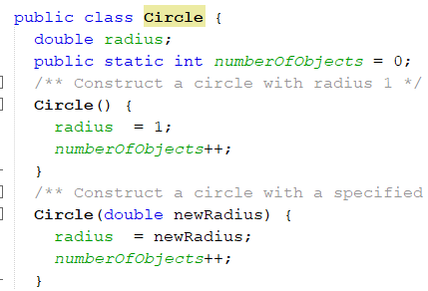
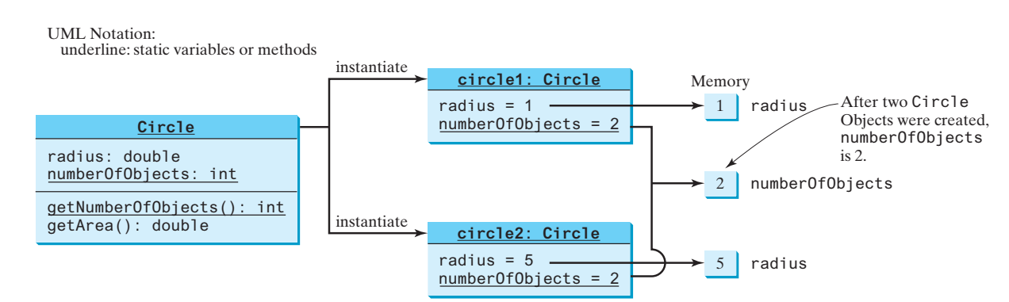
Class Variables: Static Variables
Belong to the class as a whole.
Shared by all the instances of the class.
All objects of the class can read and change static variables.
Syntax:
accessModifier static dataType variableName;
accessModifier static final dataType variableName = ConstantValue;
Examples:
public static final double PI = 3.14159;
private static String lastUser;
static int turn = 0;
Notes:
Static variables are also known as class variable because they are associated with the class and common for all the instances of class. For example, If I create three objects of a class and access this static variable, it would be common for all, the changes made to the variable using one of the object would reflect when you access it through other objects.
When you define a static variable, you place the keyword static in the heading of the definition.

Slide 36
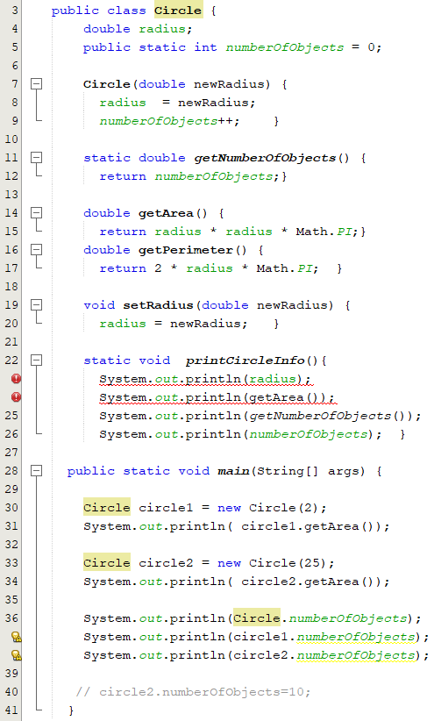
Instance and Static Methods
Instance Methods
Can access all class members (instance and static)
Instance members.
Static members.
Static Methods
Used to access only static members.
Can not invoke instance methods.
Can not access instance data fields.
Can be used without a calling object.
AccessModifier static dataType methodName(parameterList){
// statement
}

Slide 37
Instance and Static Members
Instance Members | Static Members
Declared without the modifier static double noOfCircles; AccessModifier dataType methodName(parameters){} | Declared with the modifier static static double noOfCircles; static dataType methodName(parameters){}
Tied to a specific object/instance of the class; not shared among objects of the same class. | Shared by all objects of the class. Don’t belong to a particular object. Belong to a class.
An instance method can access both instance and static members. | A static method can access only static members.
Can be called only with an object of the class circle.radius | Can be called with an object of the class or using the ClassName. circle.noOfCircles or SimpleCircle.noOfCircles
Can be accessed through an object inside static method. | The this reference cannot be used in a static method
You can access both static and instance members in the constructor.
How do you decide whether a variable or a method should be instance or static?
Notes:
The radius in circle1 is independent of the radius in circle2 and is stored in a different memory location. Changes made to circle1’s radius do not affect circle2’s radius, and vice versa .
instance members belong to instances and can be used only after the instances are created use the class name in place of a calling object.

Slide 38
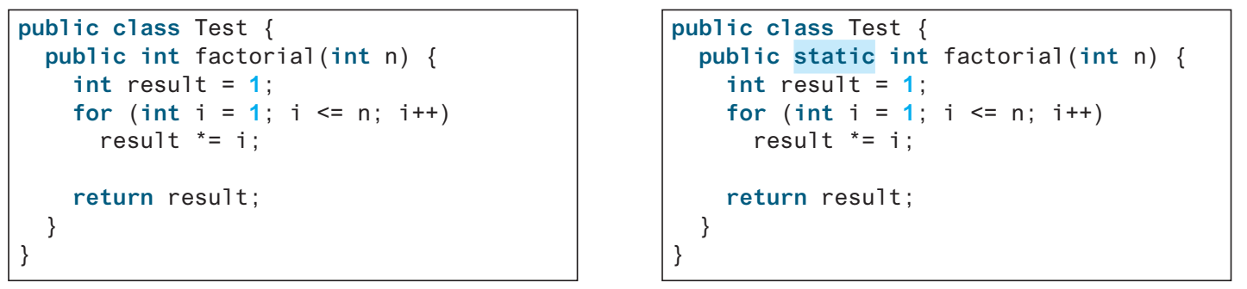
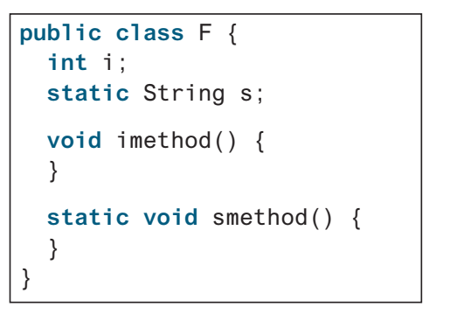
Popup-Question(7)
Which is a correct design?
9.7.1: Given the class F, which statements are correct
1
2
3
4
5
6
7
8
9
F f = new F();
System.out.println(f.i);
System.out.println(f.s);
f.imethod();
f.smethod();
System.out.println(F.i);
System.out.println(F.s);
F.imethod();
F.smethod();
√
√
√
√
√
×
√
×
√

Slide 39
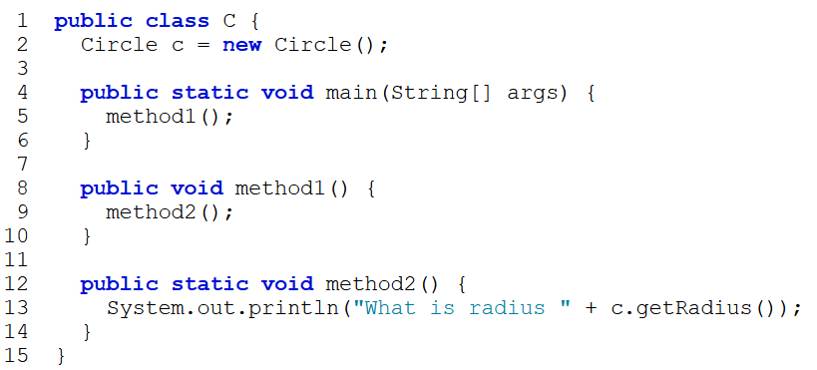
Popup-Question(8)
9.7.3 What is wrong in the following code segments?
- The main method is static and cannot invoke the instance method method1.
- c is an instance variable, which cannot be accessed from the static context in method2.
public class Test {
int count;
public static int getCount() {
return count; }
}
Static methods cannot access instance members

Slide 40
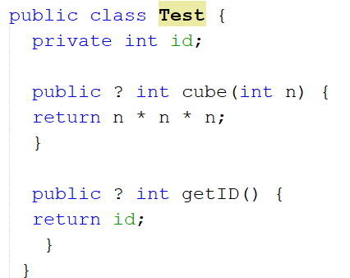
Popup-Question(9)
In which line, we can add the static keyword in the place of “?” ? Why?
Static can be added here.
Static can not be added here.

Slide 41
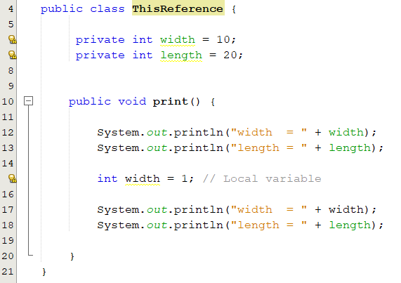
This Reference (Keyword)
The this keyword refers to the current object in an instance method or constructor.
The most common use of the this keyword:
Access a class’s hidden data fields: eliminate the confusion between class attributes and parameters/local variable with the same name.
public class Circle {
private double radius;
Circle( double radius ){
this.radius = radius;
}
}
It is a good practice to use the data field as the parameter name in a setter method or a constructor
If a local variable has the same name as a class’s variable, the local variable takes precedence and the class’s variable with the same name is hidden.
Notes:
Instance methods receive an argument call this, which refers to the current object

Slide 42
Data Field Encapsulation(1/3)
Public variables in a class can be modified directly.
Data may be tampered with:
numberOfObjects may be mistakenly set to an arbitrary value.
The class becomes difficult to maintain
Assume that we modify the class to ensure that the radius is nonnegative.
You have to change not only the Circle class but also the programs that use it because the clients may have modified the radius directly
Circle circle2 = new Circle(25);
circle2.numberOfObjects=10;
circle2.radius = -2;
Data may be tampered with
Notes:
Encapsulation refers to the bundling of fields and methods inside a single class.

Slide 43
Data Field Encapsulation(2/3)
We can not access a private data field by an object from outside the class that defines that private field.
We need to retrieve and modify a data field. How can we make it accessible?
Solution:
Provide a public getter (accessor) method to return its value.
Provide a public setter (setter) method to set a new value.
Getter signature:
public returnType getPropertyName()
Example: public double getRadius()
Setter signature:
public void setPropertyName(dataType propertyValue)
Example: void setRadius(double newRadius)
Notes:
A private data field cannot be accessed by an object from outside the class that defines the private field.
Once you label an instance variable as private, there is then no way to change its value (nor to reference the instance variable in any other way) except by using one of the methods belonging to the class.
A getter method has the following signature:

Slide 44
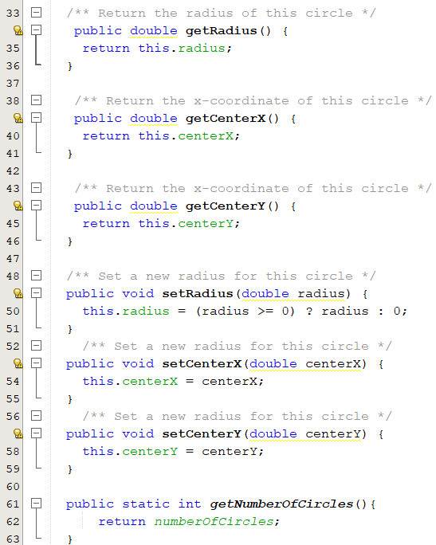
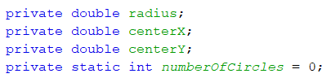
Data Field Encapsulation(3/3)
CircleWithEncapsulation
-radius: double -centerX:int -centerY:int -numberOfCircles:int
+getRadius(): double +setRadius():void +getCenterX():double +setCenterX(double centerX): void +getCenterY():double +setCenterY(double centerY): void +getNumberOfCircles()
The accessor and setter methods
The - sign indicates a private modifier
The + sign indicates a public modifier
CircleWithEncapsulationTest.java

Slide 45
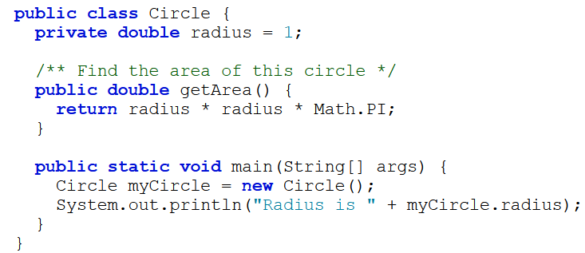
Popup-Question(10): checkpoint 9.9.3
Does the following code cause any problems? explain why.
Not a problem. Though radius is private, myCircle.radius is used inside the Circle class. Thus, it is fine.

Slide 46
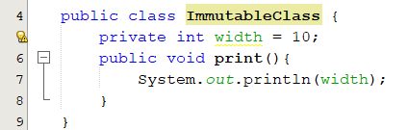
Immutable Objects and Classes
Objects whose contents cannot be changed once they are created.
instance fields cannot be changed after the object is created
All data fields must be private.
There can’t be any setter methods for data fields.
No accessor methods can return a reference to a data field that is mutable.
No constructor assigns a passed mutable object reference to an instance reference variable.
Examples: String
Accessor methods and constructors may have mutable-object instance variables leaked to code outside the class making private modifier useless.

Slide 47
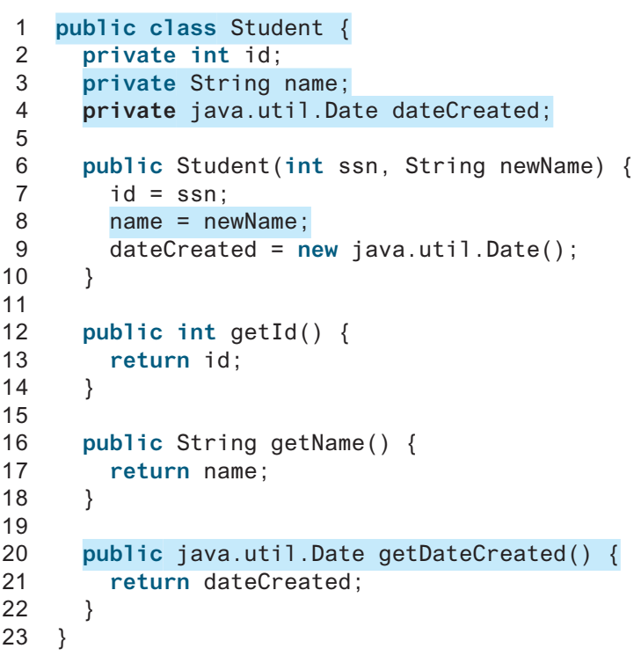
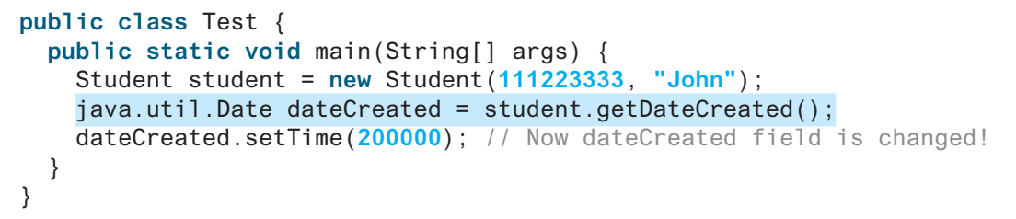
Mutable Object Reference Leaks: Example 1

Slide 48
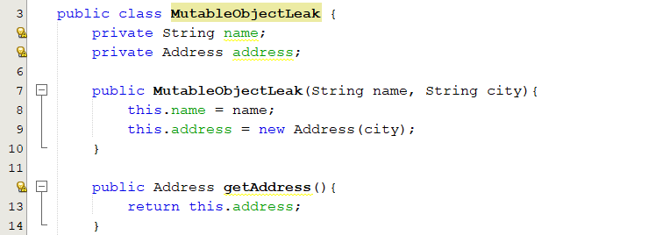
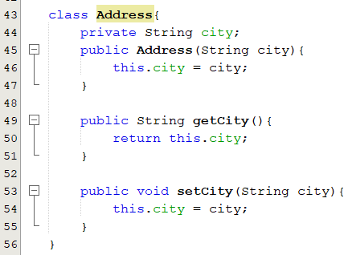
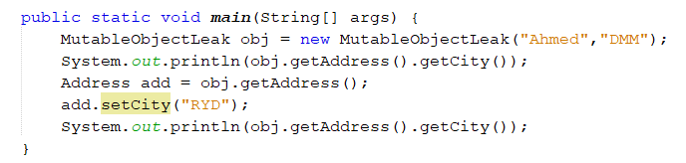
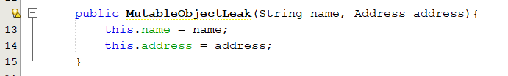
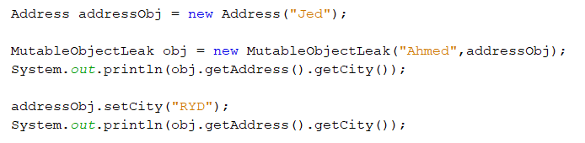
Mutable Object Reference Leaks: Example 2
1. A getter leak
How can we solve it?
Output:
DMM
RYD
public Address getAddress(){
return new Address(this.address.getCity());
}
2. Constructor leak
How can we solve it?
this.address = new Address(address.getCity());
Notes:
A constructor must not assign a passed mutable object reference to an instance reference variable;
it should rather copy the contents of the object to a new object and then assign the reference of the new object to the instance reference variable.

Slide 49
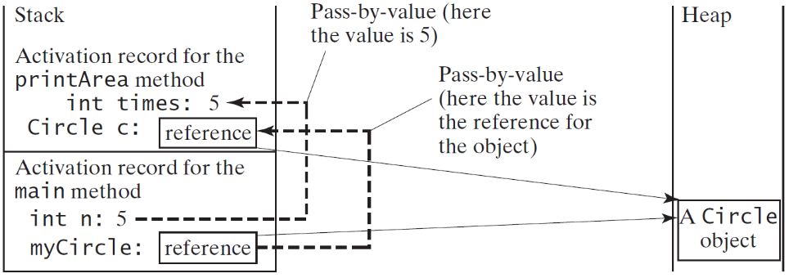
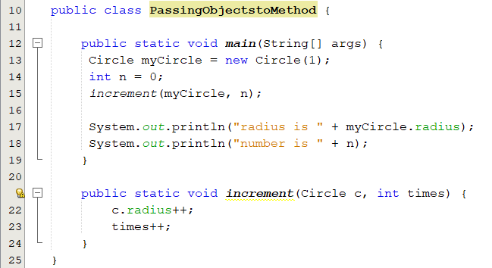
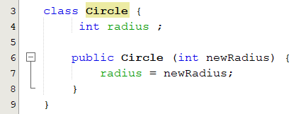
Passing Objects to Methods
Passing an object to a method is to pass the reference of the object.
Changing the properties of the object inside the method has the same effect as doing so outside the method.
Changing the reference to point to another object inside the method has no effect.
Notes:
Java uses exactly one mode of passing arguments: pass-by-value

Slide 50
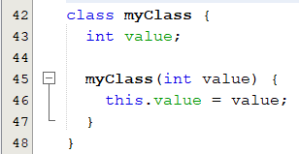
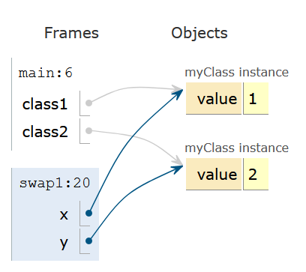
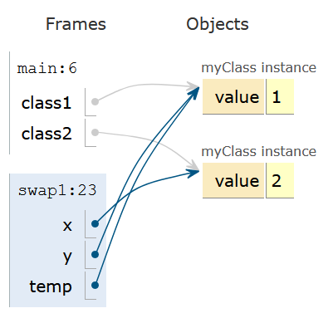
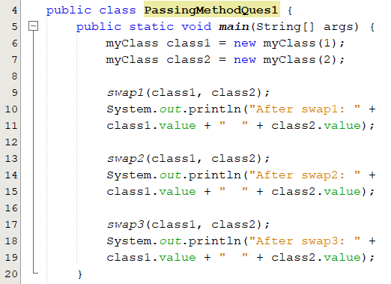
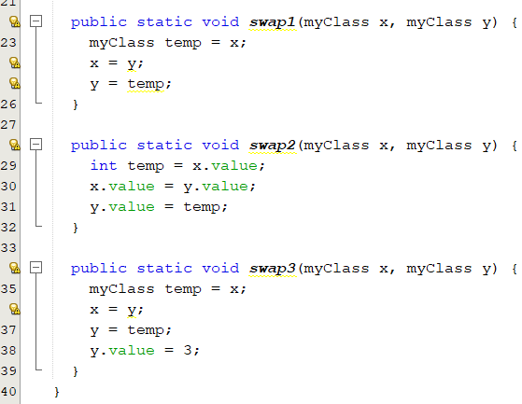
Popup-Question(11): Show the output of the following program?
After swap1: 1 2
At the beginning of the method swap1
After swap2: 2 1
At the end of the method swap1
After swap3: 3 1

Slide 51
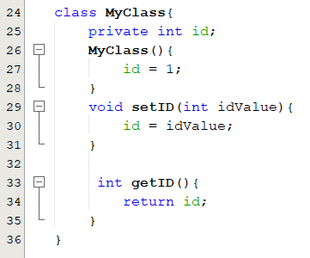

Popup-Question(12)
What is the output of the following programs?
Output
2 //We change the object’s attribute
NullPointerException

Slide 52

Popup-Question(13)
What is wrong in the following code?
NullPointerException
Object circles[1] has not been created.

Slide 53
Anonymous Objects
An object created in this way is known as an anonymous object.
Has no reference
Created on the fly
Example:
new SimpleCircle();
or
System.out.println("Area is" + new SimpleCircle(5).getArea());

Slide 54



Array of Objects(1/2)
An array of objects is created just like an array of primitive type data items.
circleArray contains a reference to an array and each element in the array can hold a reference to a Circle object.
Circle[] circleArray = new Circle[10]; // circleArray[0] is null

Slide 55

Array of Objects(2/2)

Slide 56
Scope of Variables
The scope of instance and static variables is the entire class. They can be declared anywhere inside a class.
The scope of a local variable starts from its declaration and continues to the end of the block that contains the variable.
Class
Variables
Constructors
Methods
Local variables

Slide 57

Popup-Question(14): checkpoint 9.13.1
What is the output of the following program?
Output:
i + j is 5
k is 2
j is 0

Slide 58

Constructor Overloading
A class can have more than one constructor with different signatures.
This allows the user to have as many options as possible when creating objects of the class, thus making the class more flexible to use.
this keyword is used to invoke current class constructor.
Which constructor is invoked?
We need to add if statements only here →

Slide 59
Call Chain of Constructors
The process of calling one constructor from another constructor with respect to the current object.
Within the same class: It can be done using this() keyword for constructors in same class
this statement should be the first statement in the constructor
Syntax:
this(arguments)
Notes:
Whenever a class or struct is created or instantiated, the constructor of the corresponding class is called. The classes can have multiple constructors with different arguments to allow you to flexibly craft them to your own needs.
Constructor chaining is strongly coupled with constructor overloading.
Overloading means creating different versions for our constructor to accommodate the needs of different situatio

Slide 60

Popup-Question(15): Checkpoint 9.14.2
What is wrong in the following code?
Swap line 5 with line 6
Lines 10, 14, should be this.p = p;

